Slide 1
JUNIOR CYCLE Level 2 Parent Information

Slide 2
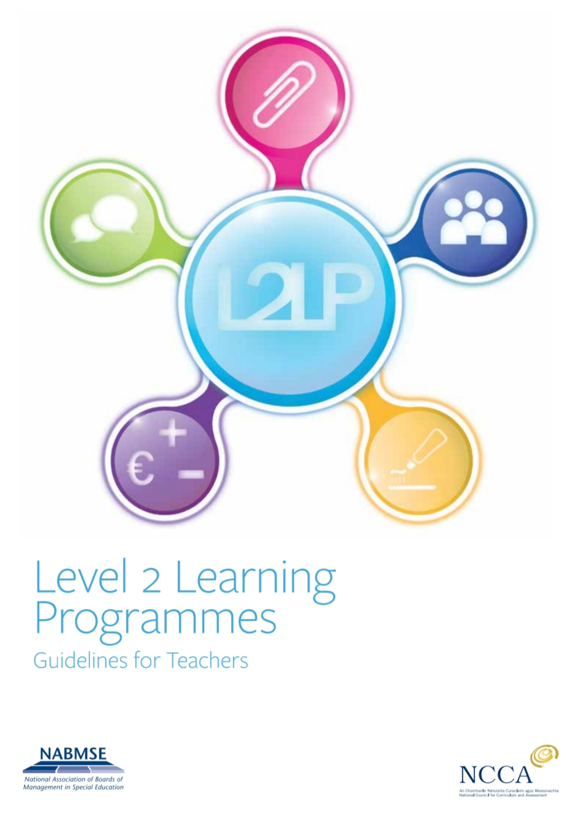

Slide 3
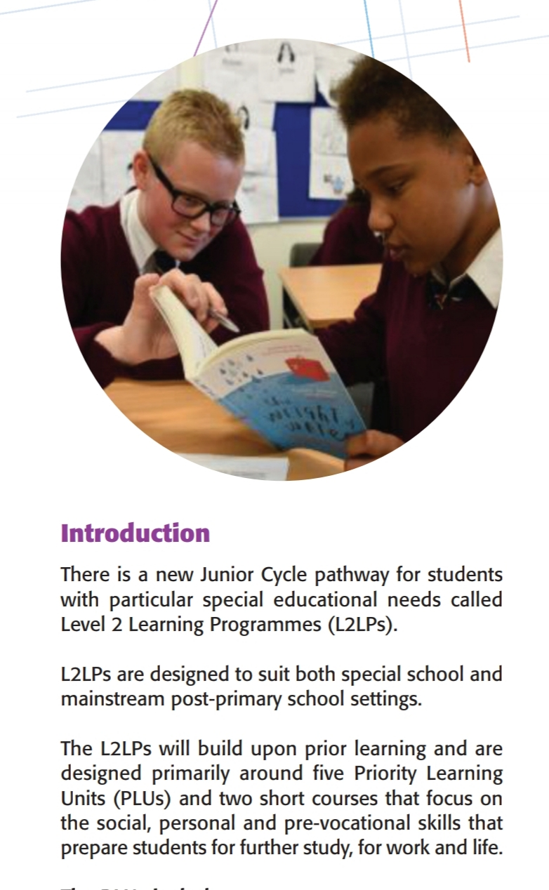

Slide 4
Introduction to the Programme
Students need to spend 3 years working on the JC2 programme to successfully engage with all of the learning outcomes.
Evidence of learning is recorded and collected continuously throughout the programme.
The JC2 programme does not involve state exams in June at the end of the 3 years.
We have 3 year groups and each class consists of pupils from the same year.
This year, our school has 7 classes working on the JC programme.

Slide 5
Key Terms
JC - Junior Cycle
L2LPs – Level 2 Learning Programmes in the Junior Cycle
PLU (Priority Learning Unit) - these are the subject areas of the Junior cycle programme programme
Element – each PLU is further broken down into elements. Each element contains a different amount of learning outcomes (L.O.s)
L.O. (learning outcome) – this is the list of skills/ learning that each student needs to achieve
CBA (Classroom based assessment)
SC –Short Course

Slide 6
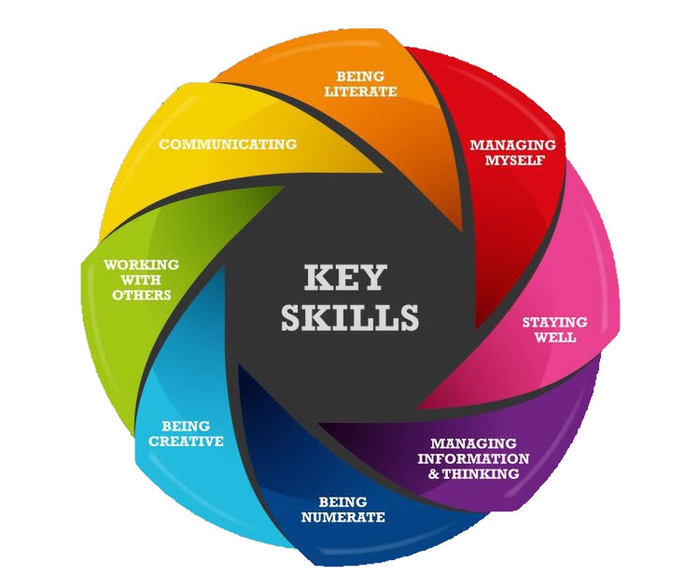
The Key Skills and 24 statements of Learning are for all Junior Cycle pupils at levels 1,2 and 3.
These skills are developed throughout the 3 years of the Junior Cycle programme.

Slide 8
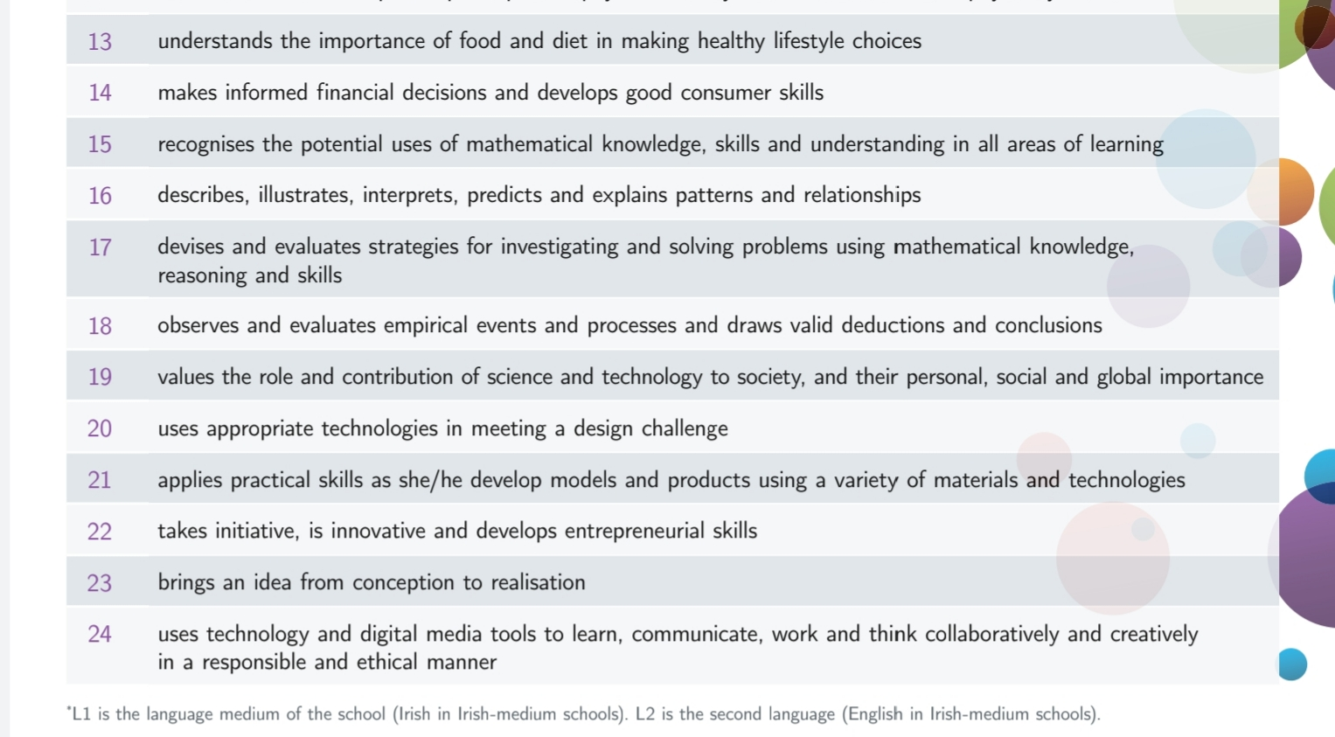

Slide 9
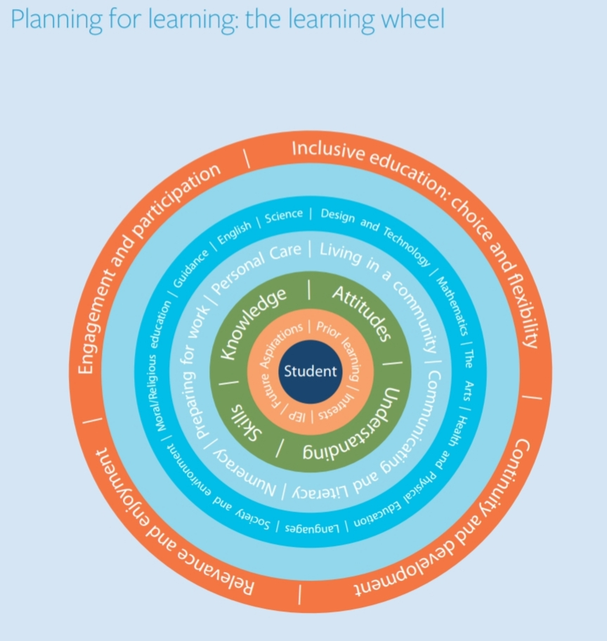
The Junior Cycle Level 2 programme is student focused with the students and their learning prioritised at all times.

Slide 10
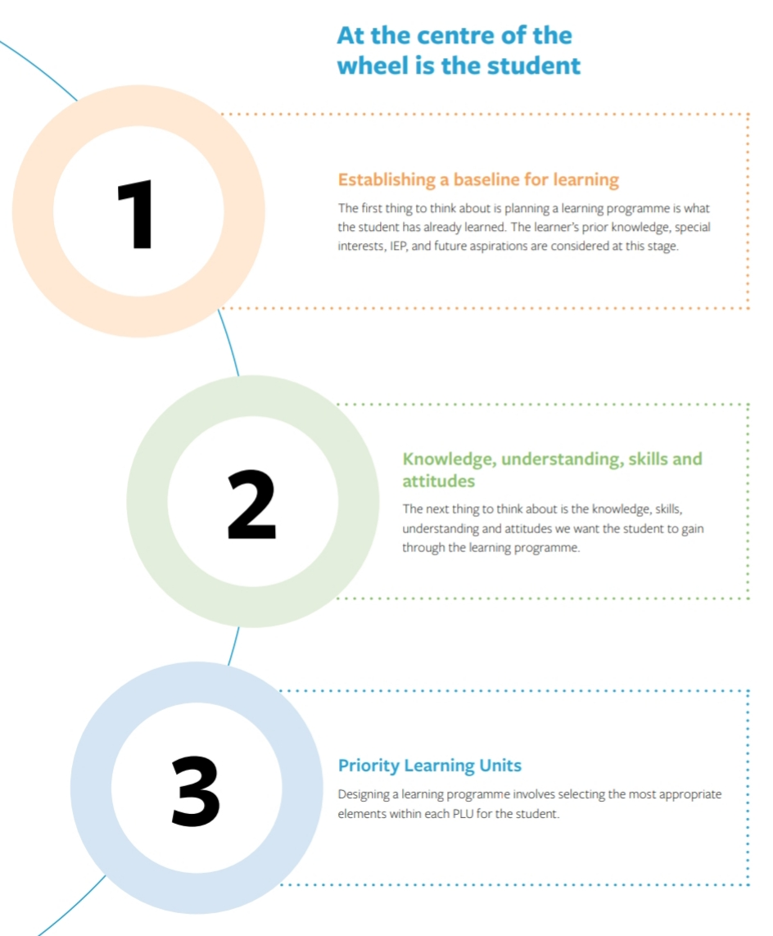

Slide 11
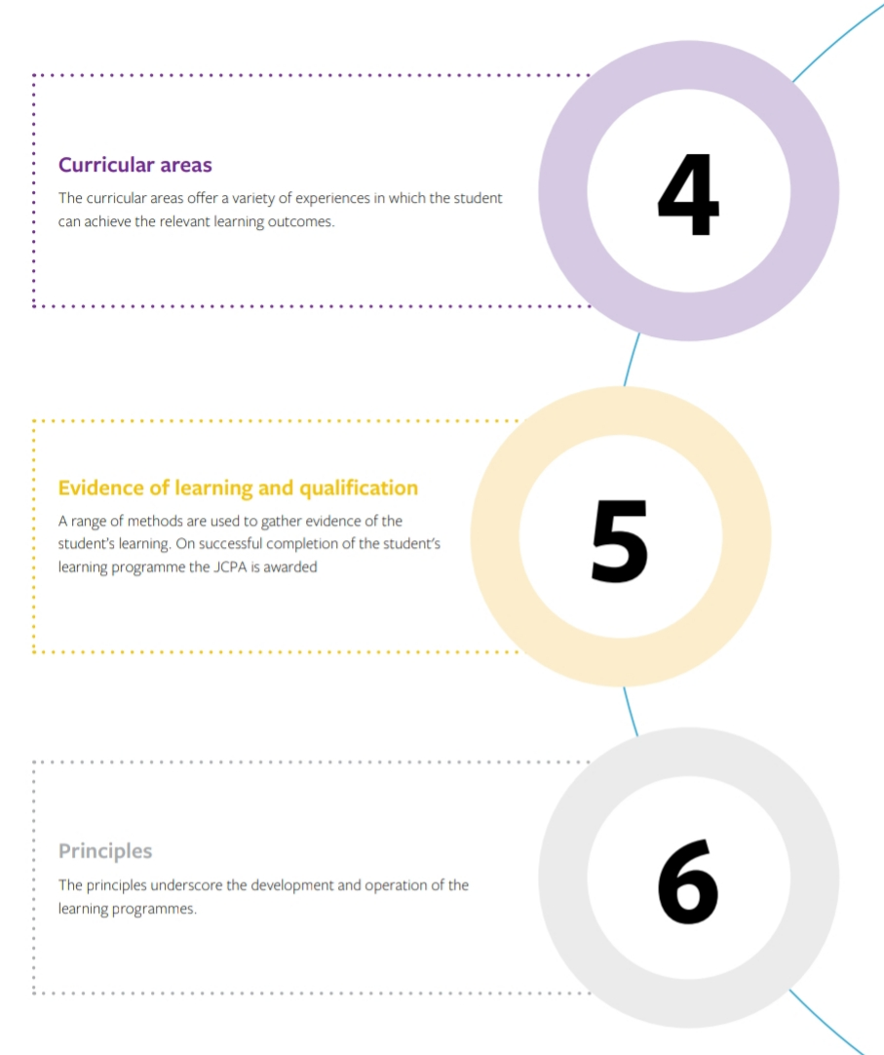

Slide 12
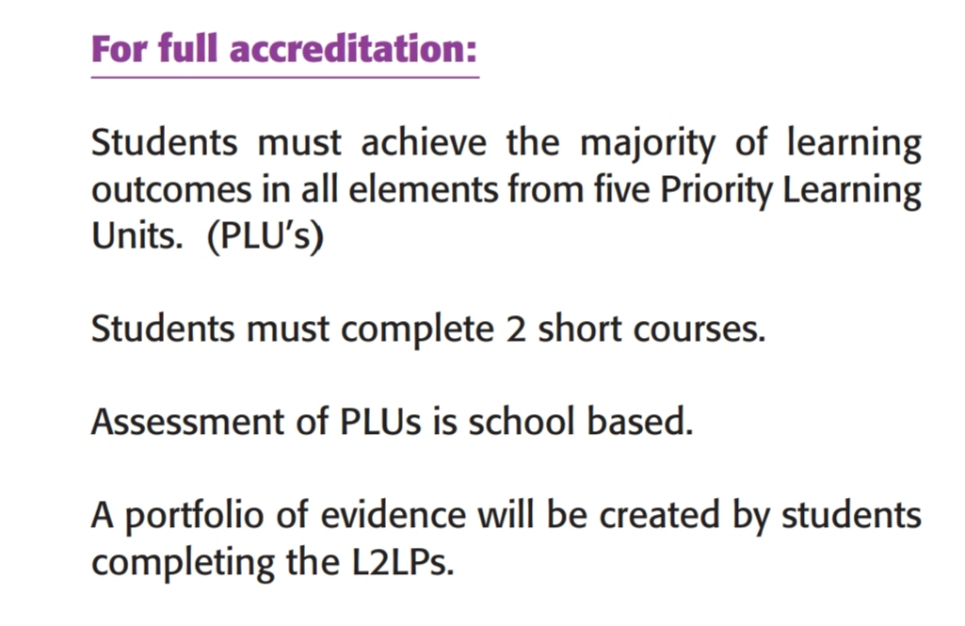

Slide 13
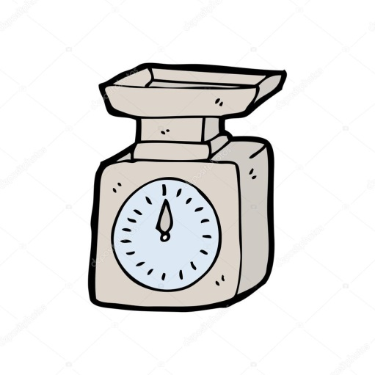
Short Courses
Students must complete two short courses as part of the Junior Cycle.
These short courses run throughout the 3+ years of the Programme.
T he short courses offered in St. Michael’s Holy Angels are Woodwork and Home
Pupils will take part in a wellbeing programme and may also do a short course in Civic, Social and Political Education (CSPE), Social, Personal and Health Education (SPHE) or Physical Education(P.E)

Slide 14
The 5 PLUs of the JC2 Programme

Slide 15
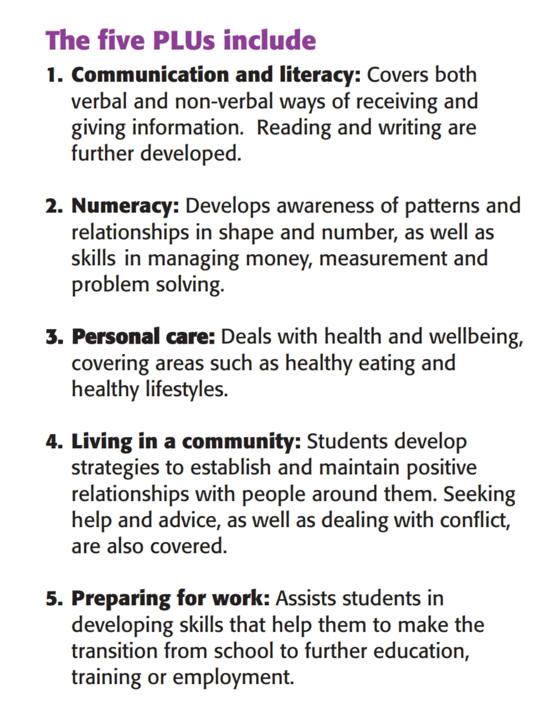

Slide 16
Priority Learning Units (PLUs)
The PLUs are broken down into a list of elements. The following slides will show each PLU and the relevant elements.

Slide 22
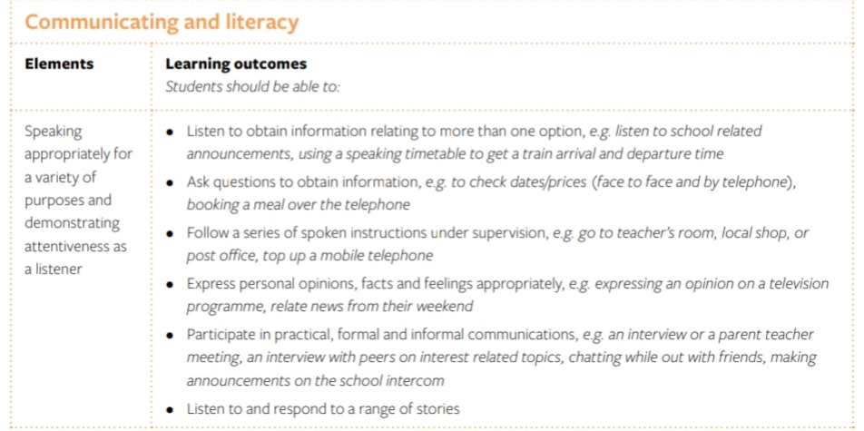
Priority Learning Units (PLUs)
Each element contains a list of Learning Outcomes (L.O.s)
For example, in the PLU Communicating and Literacy, the first element is ‘speaking appropriately for a variety of purposes and demonstrating attentiveness as a listener’. This element is further broken down into the Learning Outcomes. There are 6 Learning Outcomes in this element.

Slide 23
Other areas of learning:
In year 3 of the Junior Cycle programme, pupils will complete the areas of learning required for the level 2 (the 5 PLUs and 2 short courses). However the programme also includes a collection of all of the different areas of learning that takes place in our school eg: involvement with the Green-Schools’ Committee, the Student Council, the Active Schools’ Committee, choir etc.
These other areas of learning are guided by the Junior Cycle key skills and the 24 statements of learning. They are incorporated into the programme where appropriate.

Slide 24
Other subjects
We offer a broad and balanced curriculum through the JC2 programme.
Some subjects are always taught explicitly (Home Economics, PE, Religion, SPHE).
Other subjects are taught through the lens of one of the PLU subject areas (music, art, geography, science etc). For example, the Element Using Expressive Arts to Communicate in the PLU Communicating and Literacy lends itself well to the Arts subjects so Art, Music and Drama can be taught through this Element.
.

Slide 25
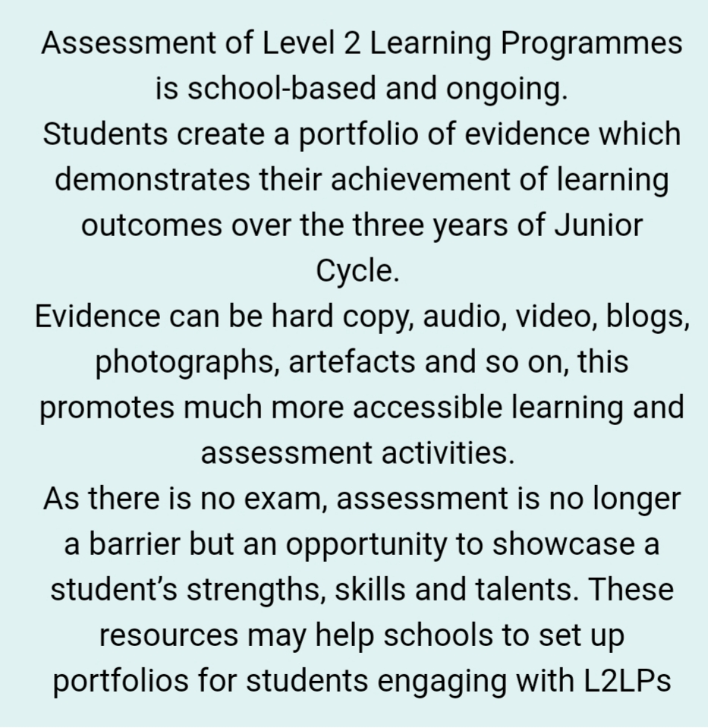
Assessment

Slide 26
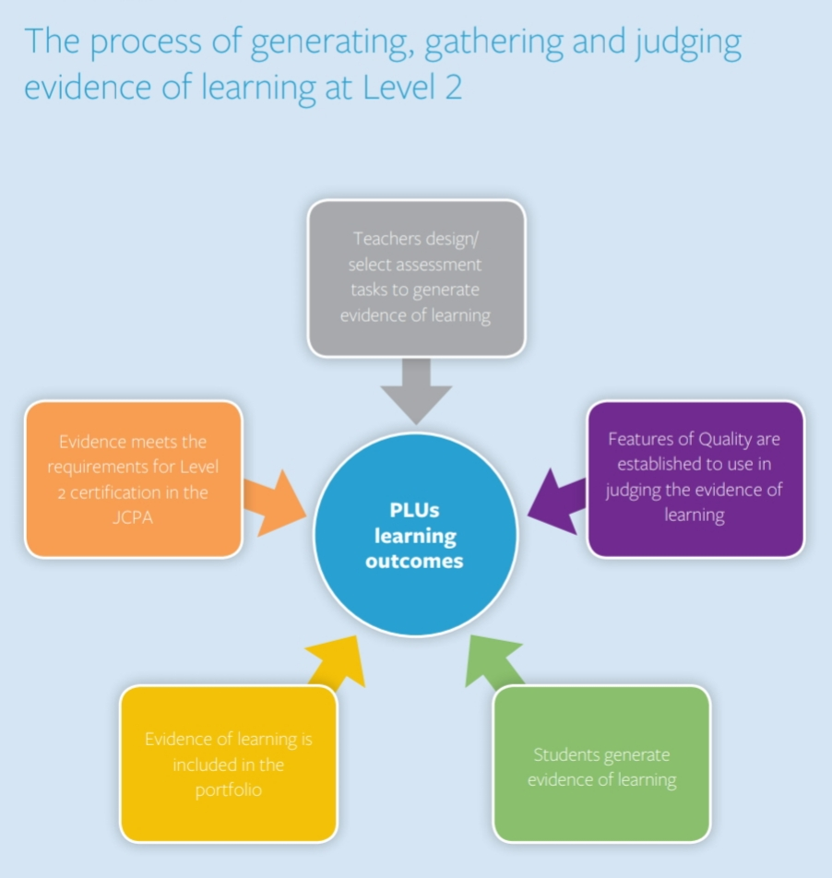
Collecting Evidence
Evidence collection is teacher led.
It can include worksheets, work samples, assessments, ePortfolios, observations, checklists, photographs, audio recordings etc
The evidence of learning is recorded in the students’ assessment folders.

Slide 27
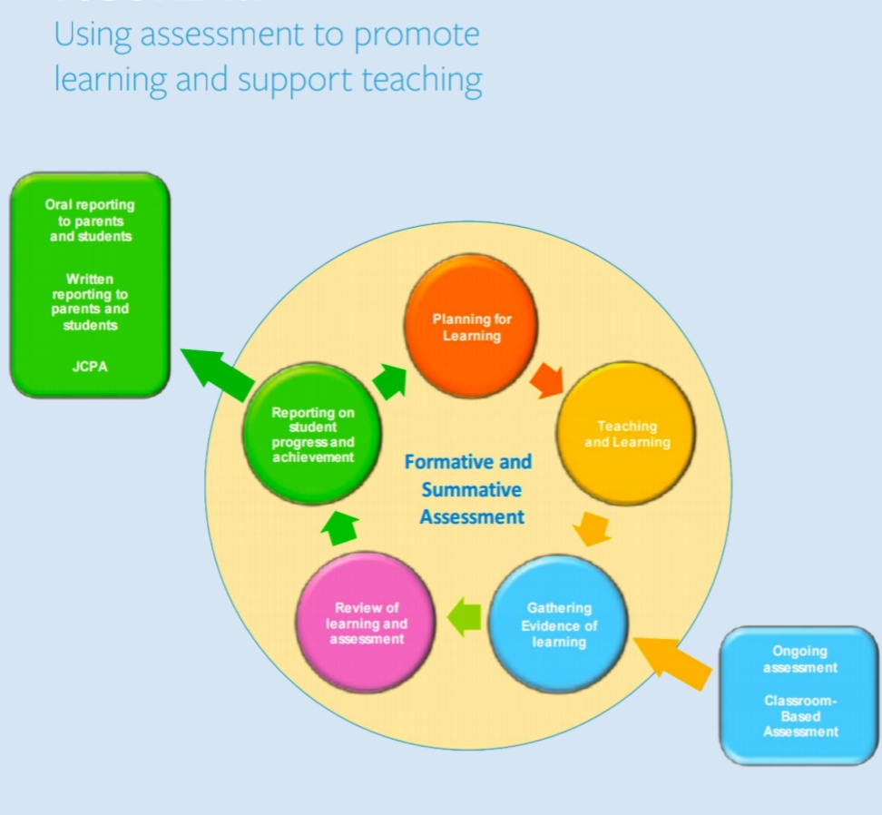

Slide 28
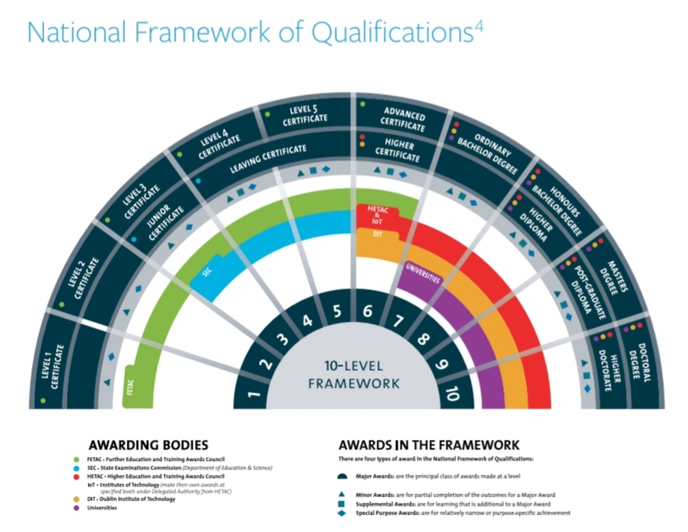
When finished, 2 the Junior Cycle level 2 students are at level 2 on the National Framework of Qualifications in Ireland.

Slide 29
Certification
The Junior Cycle exam results for level 3 are released by the State Examinations Committee in the September.
In St. Michael’s School students who were following the Level 2 programme will have their evidence internally moderated and receive confirmation of their results on the same day as those who did level 3.
The Junior Cycle Profile of Achievement (formerly Junior Certificate) is received by level 1,2,and 3 pupils throughout Ireland usually in January.

